Slide 1
SEMANTIC ANALYSIS

Slide 2
Semantic Analysis
Parser builds abstract syntax tree
Now, compiler needs to extract semantic information and check constraints
It can sometimes be done during the parse, but often easier to organize as a separate pass
It is the last phase in front end

Slide 3
Semantic Analysis
Extract types and other information from the program
Check language rules that go beyond the grammar
Assign storage locations
Key data structure: Symbol Tables – For each identiﬁer in the program, record its attributes (kind, type, etc.)

Slide 4
Semantic Analysis
Lexical analysis: detecting illegal tokens (e.g., string constant too long, illegal characters in the string)
Syntax analysis: structure errors, no parse tree for the string according to given grammar (brackets don’t match)

Slide 5
Semantic Analysis
Semantic analysis (dependent on the language): e.g., specifying wrong types (int a = b+c (c cannot be string)), buffer overﬂows, divide by zero
Scoping: e.g., all variables must be declared
Typing: certain operations only can be performed on the certain types of variables; e.g., actual parameter types have to match formal parameter types

Slide 6
Typical Semantic Errors
The following are some of the semantics errors that the semantic analyzer is expected to encounter:
Type mismatch
Undeclared variable
Reserved identiﬁer misuse
Multiple declaration of variable in a scope
Accessing an out of scope variable
Actual and formal parameter mismatch

Slide 7
Typical Semantic Errors
The type of the right-side expression of an assignment statement should match the type of the left-side, and the left-side needs to be a properly declared and assignable identiﬁer (i.e. not some sort of constant)
The parameters of a function should match the arguments of a function call in both number and type

Slide 8
Typical Semantic Errors
The language may require that identiﬁers are unique, disallowing a global variable and function of the same name
The operands to multiplication operation will need to be of numeric type, perhaps even the exact same type depending on the strictness of the language

Slide 9
Scoping
Match identiﬁers' declaration with uses
Visibility of an entity
Binding between declaration and uses
The scope of an identiﬁer is the portion of a program in which that identiﬁer is accessible
The same identiﬁer may refer to different things in different parts of the program: Different scopes for same name don’t overlap
An identiﬁer may have restricted scope

Slide 10
Static vs Dynamic Scope
Most languages have static scope: Scope depends only on the program text, not runtime behavior (e.g., Java, C)
A few languages are dynamically scoped: Scope depends on execution of the program (e.g., Lisp, SNOBOL, Perl allow dynamic scope through certain keywords) – context speciﬁc scoping
Dynamic scoping means that when a symbol is referenced, the compiler/interpreter will walk up the symbol-table stack to ﬁnd the correct instance of the variable to use

Slide 11
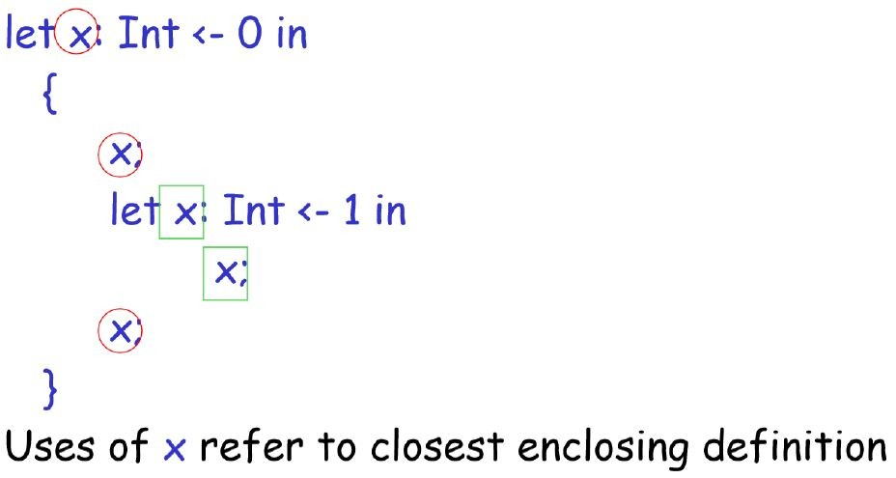
Static Scope

Slide 12
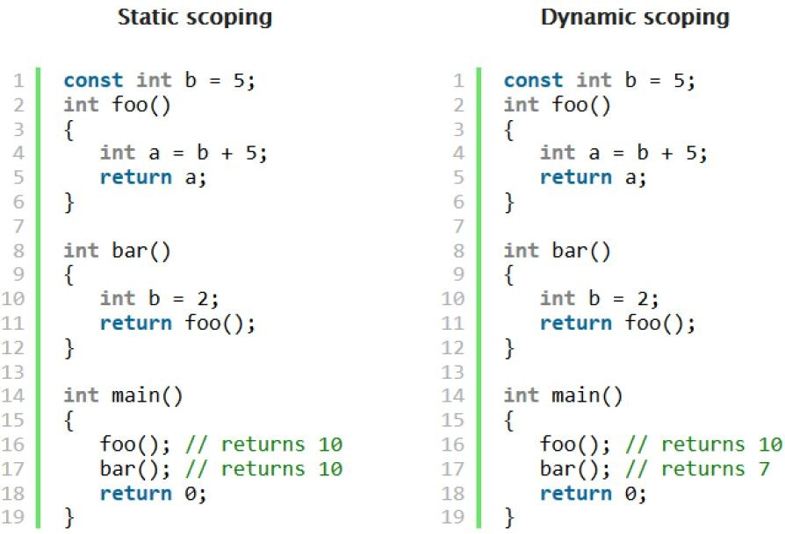

Slide 13
Syntax-Directed Translation
Grammar symbols are associated with attributes to associate information with the programming language constructs that they represent
Values of these attributes are evaluated by the semantic rules associated with the grammar productions
The way of associating attributes to each of the symbols in the grammar that provides us the order of translation, allowing some level of implementation is
called syntax directed translation

Slide 14
Syntax-Directed Translation
Evaluation of these semantic rules:
may generate intermediate codes
may put information into the symbol table
may perform type checking
may issue error messages
An attribute may hold a string, a number, a memory location, a complex record

Slide 15
Syntax-Directed Translation
When we associate semantic rules with productions, we use two notations:
Syntax-Directed Deﬁnitions
Translation Schemes
Syntax-Directed Deﬁnitions are high level speciﬁcations for translations. They hide many implementation details and free the user from having to explicitly specify the order in which translation takes place.

Slide 16
Syntax-Directed Translation
Translation Schemes indicate the order in which semantic rules are to be evaluated (using a dependency graph), so they allow some implementation details to be shown.

Slide 17
Syntax-Directed Deﬁnitions
Syntax-directed deﬁnitions (or attribute grammar) bind a set of semantic rules to productions
They are the high level speciﬁcation for the translation schemes i.e. they hide the implementation details and do not necessitate the consideration of translations order
It is the generalization of parse tree where each terminal and nonterminal has attributes associated to it whose values are determined by the semantic rules

Slide 18
Syntax-Directed Deﬁnitions
A syntax-directed deﬁnition is a generalization of a context-free grammar in which:
Each grammar symbol is associated with a set of attributes.
This set of attributes for a grammar symbol is partitioned into two subsets called synthesized and inherited attributes.
Each production rule is associated with a set of semantic rules

Slide 19
Syntax-Directed Deﬁnitions
Semantic rules set up dependencies between attributes which can be represented by a dependency graph
This dependency graph determines the evaluation order of these semantic rules
If the value of the attribute only depends upon its children then it is synthesized attribute
The syntax directed deﬁnition with only synthesized attribute is called S-attributed deﬁnition or S- attributed grammar

Slide 20
Syntax-Directed Deﬁnitions
If the value of the attribute depends upon its parent or siblings then it is inherited attribute
A parse tree showing the values of attributes at each node is called an annotated parse tree
The process of computing the attributes’ values at the nodes is called annotating (or decorating) of the parse tree

Slide 21
In a syntax-directed deﬁnition, each production A→α is associated with a set of semantic rules of the form:
b = f(c₁, c₂, …, c_{n})
where f is a function, c₁, c₂, …, c_{n} are attributes of the grammar symbols in the production A→α and either
b is a synthesized attribute of A
b is an inherited attribute of one of the grammar symbols in α
So, a semantic rule b = f(c₁, c₂, …, c_{n}) indicates that the attribute b depends on attributes c₁, c₂, …, c_{n}

Slide 22
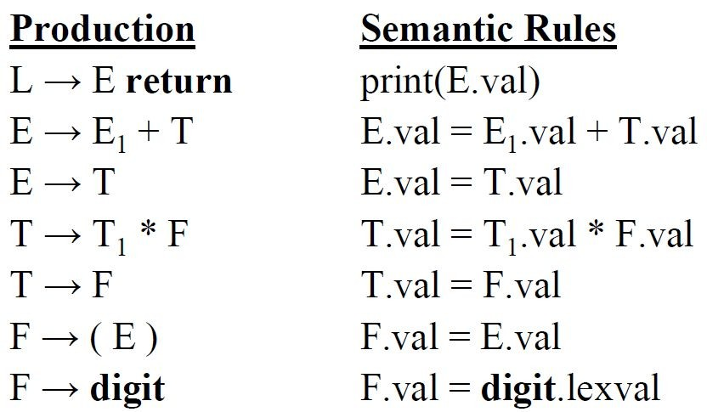
Example:
All attributes in this example are of the synthesized type. Symbols
E, T, and F are associated with a synthesized attribute val. The
token digit has a synthesized attribute lexval (it is assumed that it is evaluated by the lexical analyzer).

Slide 23
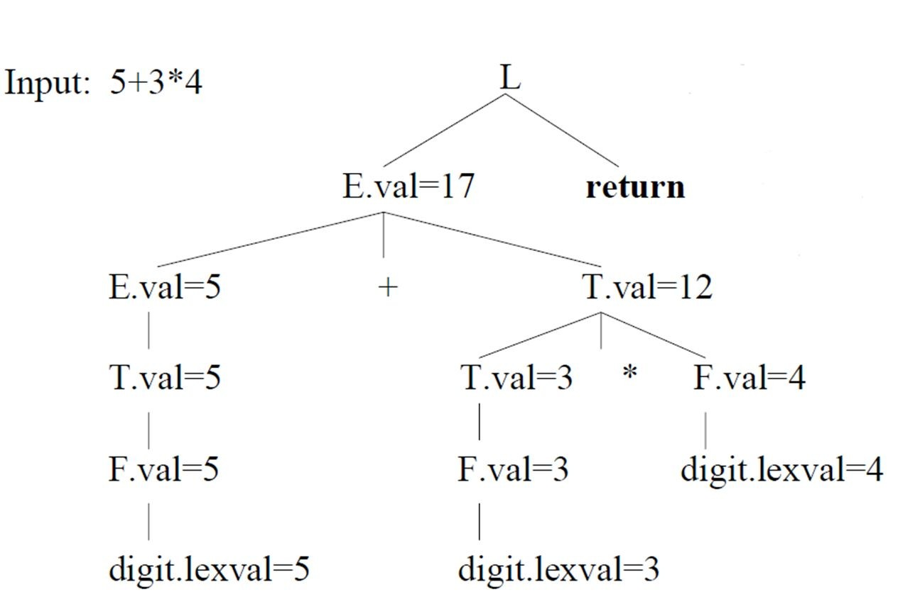
Annotated Parse Tree
Computation starts from leaf node with associated production and corresponding semantic rule. Output: The value, printed at the root of tree, is the value of E.val at the ﬁrst child of the root.

Slide 24
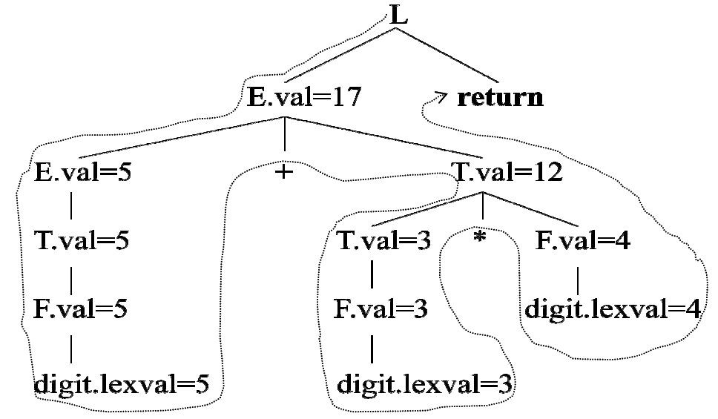

Slide 25
Inherited Attributes
An inherited attribute at any node is deﬁned based on the attributes at the parent and/or siblings of the node
They are useful for describing context sensitive behavior of grammar symbols
For example, an inherited attribute can be used to keep track of whether an identiﬁer appears at the left or right side of an assignment operator
This can be used to decide whether the address or the value of the identiﬁer is needed

Slide 26
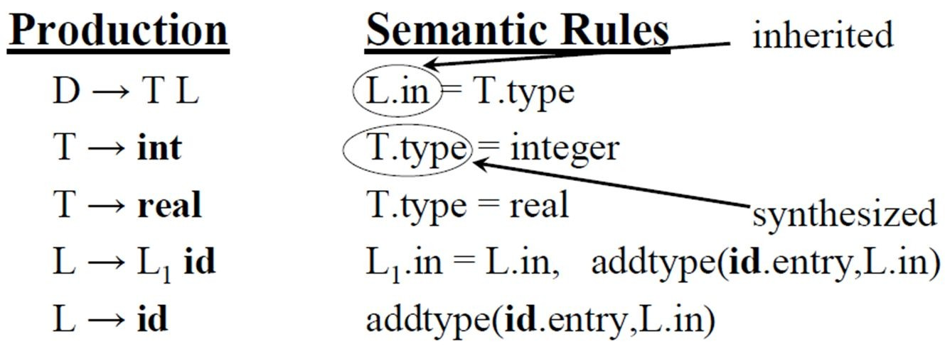
Inherited Attributes
Example
Symbol T is associated with a synthesized attribute type
Symbol L is associated with an inherited attribute in

Slide 27
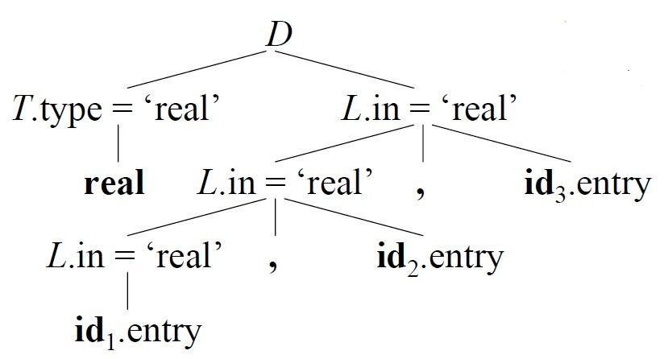
Example (Annotated Parse Tree): Input : real id1, id2, id3
The value of L.in at the three L-nodes gives the type of identiﬁers id1, id2 & id3. These values are determined by computing the value of attribute T.type at the left child of the root and then evaluating L.in in top-down at the three L-nodes in the right subtree of the root

Slide 28
Dependency Graph
In order to correctly evaluate attributes of syntax tree nodes, a dependency graph is useful
A dependency graph is a directed graph that contains attributes as nodes and dependencies across attributes as edges

Slide 29
Algorithm for dependency graph construction
for each node n in the parse tree do
for each attribute a of the grammar symbol at n do Construct a node in the dependency graph for a
for each node n in the parse tree do
for each semantic rule b = f(c₁, c₂, …, c_{k}) associated with the production used at n do
for i = 1 to k do
Construct an edge from c_{i} to the node for b

Slide 30
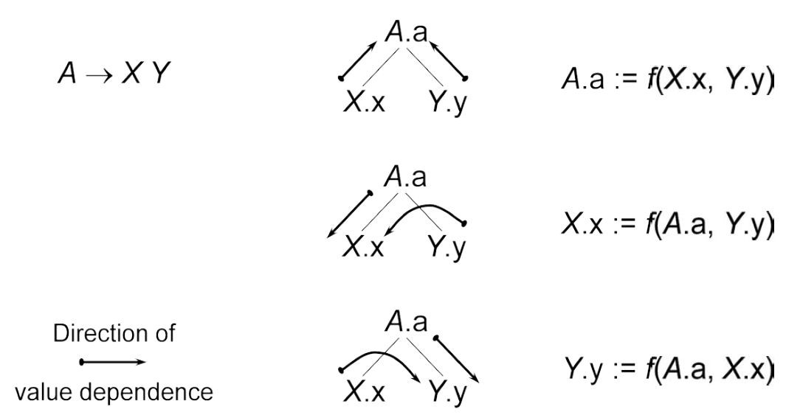
Acyclic Dependency Graphs for Parse Trees

Slide 31
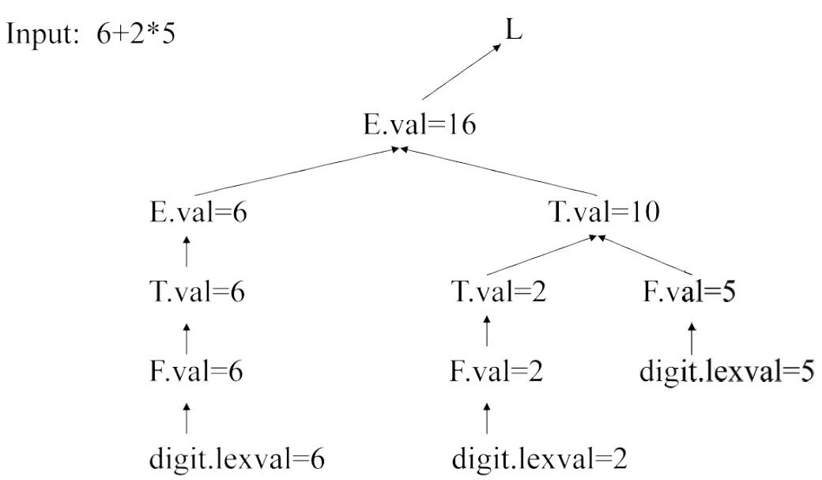
Example (Dependency Graph for Annotated Parse Tree for 6 + 2 * 5)

Slide 32
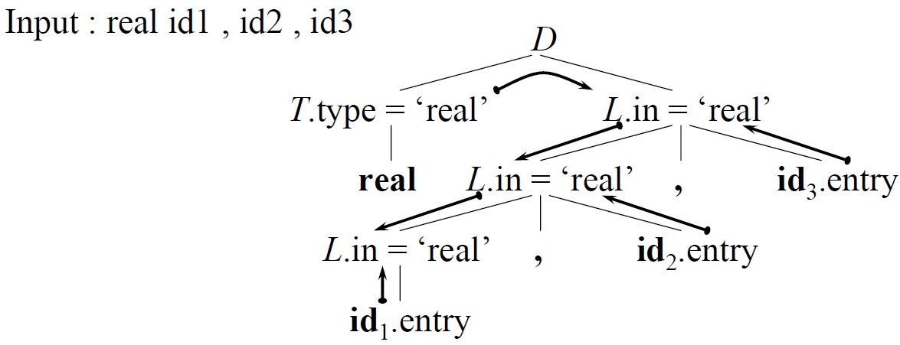
Example (Annotated Parse Tree with Dependency Graph for real id1, id2, id3)

Slide 33
S–Attributed Deﬁnitions
A syntax-directed deﬁnition that uses synthesized attributes exclusively is called an S–attributed deﬁnition (or S–attributed grammar)
A parse tree of an S–attributed deﬁnition is annotated by evaluating the semantic rules for the attribute at each node bottom-up

Slide 34
Bottom-up Evaluation of S–Attributed Deﬁnitions
An S–attributed grammar can be translated bottom-up when the grammar is being parsed using an LR parser
The bottom up parser uses a stack to hold information about subtrees that have been parsed
Let us suppose that the stack is implemented by a pair of arrays state and val
If the i^{th} state symbol is A, then val[i] will hold the value of the attribute associated with the parse tree node corresponding to A

Slide 35
Bottom-up Evaluation of S–Attributed Deﬁnitions
The current top of the stack is indicated by the pointer
top
We assume that synthesized attributes are evaluated just before each reduction
For example, A → XYZ, A.a = f(X.x, Y.y ,Z.z) where all attributes are synthesized
Before XYZ is reduced to A, the value of the attribute Z.z is in val[top], that of Y.y in val[top–1], and that of X.x in val[top–2]

Slide 36
Bottom-up Evaluation of S–Attributed Deﬁnitions
If a symbol has no attribute, then the corresponding entry in the val array is undeﬁned
After the reduction, top is decremented by 2, the state covering A is put in state[top] i.e. where X was, and the value of the synthesized attribute A.a is put in val[top]

Slide 37
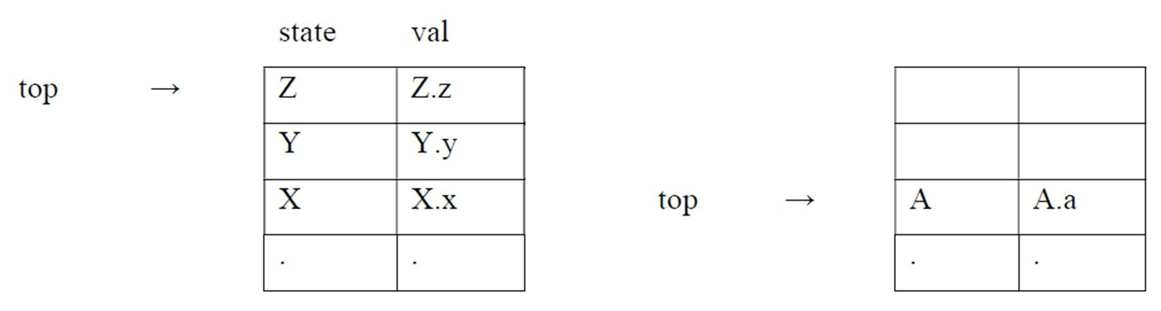
Bottom-up Evaluation of S–Attributed Deﬁnitions
🡺

Slide 38
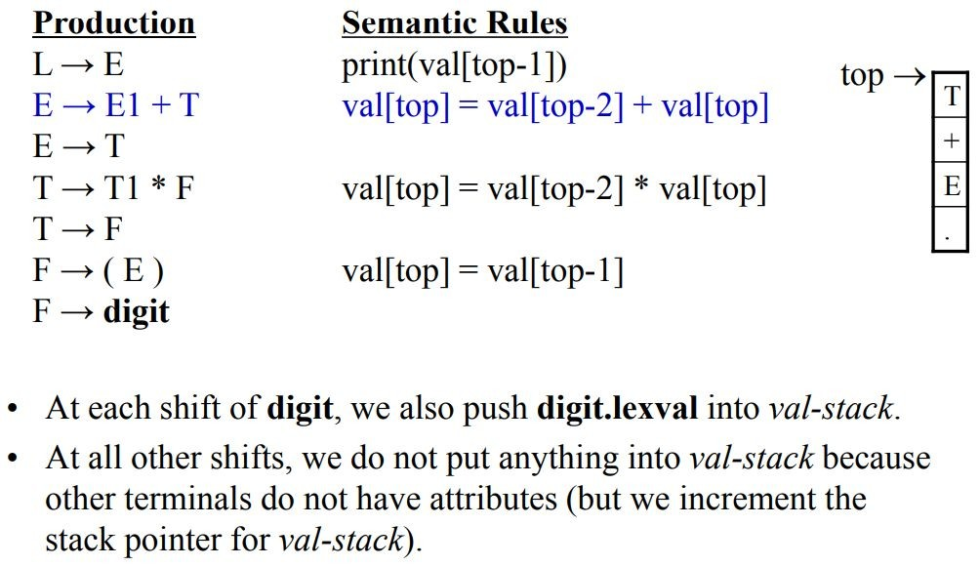

Slide 39
Stack | val-stack | Input | Action | Semantic Rule
$ |  | 6+2*5n$ | shift | d.lexval(6) into val-stack
$6 | 6 | +2*5n$ | F→d | F.val=d.lexval – do nothing
$F | 6 | +2*5n$ | T→F | T.val=F.val – do nothing
$T | 6 | +2*5n$ | E→T | E.val=T.val – do nothing
$E | 6 | +2*5n$ | shift | push empty slot into val-stack
$E+ | 6 _ | 2*5n$ | shift | d.lexval(2) into val-stack
$E+2 | 6 _ 2 | *5n$ | F→d | F.val=d.lexval – do nothing
$E+F | 6 _ 2 | *5n$ | T→F | T.val=F.val – do nothing
$E+T | 6 _ 2 | *5n$ | shift | push empty slot into val-stack
$E+T* | 6 _ 2 _ | 5n$ | shift | d.lexval(5) into val-stack
$E+T*5 | 6 _ 2 _ 5 | n$ | F→d | F.val=d.lexval – do nothing
$E+T*F | 6 _ 2 _ 5 | n$ | T→T*F | T.val=T1.val*F.val
$E+T | 6 _ 10 | n$ | E→E+T | E.val=E1.val*T.val
$E | 16 | n$ | shift | push empty slot into val-stack
$En | 16 _ | $ | L→En | print(16), pop empty slot from val-stack
$L | 16 | $ | accept
Prepared by Sherin Jos

Slide 40
L–Attributed Deﬁnition
A syntax-directed deﬁnition is L–attributed if each inherited attribute of X_{j} on the right side of A → X₁ X₂ … X_{n} depends only on
The attributes of the symbols X₁, X₂, …, X_{j-1}
The inherited attributes of A
L–attributed deﬁnitions allow for a natural order of evaluating attributes: depth-ﬁrst and left to right
Every S-attributed syntax-directed deﬁnition is also L–attributed and the above rule applies only for inherited attributes

Slide 41
Depth First Evaluation of L–Attributed Deﬁnitions
Procedure dfvisit(n: node); //depth-ﬁrst evaluation for each child m of n, from left to right do
evaluate inherited attributes of m; dfvisit(m);
evaluate synthesized attributes of n

Slide 42
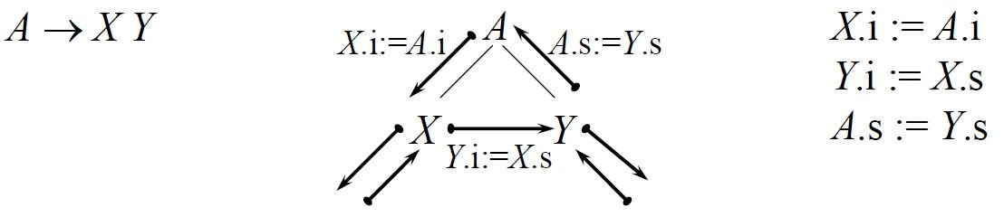
Depth First Evaluation of L–Attributed Deﬁnitions

Slide 43
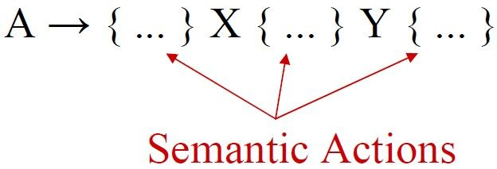
Translation Schemes
A translation scheme is a context-free grammar in which:
attributes are associated with the grammar symbols and
semantic actions enclosed between braces { } are inserted within the right sides of productions

Slide 44
Translation Schemes
In translation schemes, we use the term semantic action instead of semantic rule used in
syntax-directed deﬁnitions
The position of the semantic action on the right side indicates when that semantic action will be evaluated

Slide 45
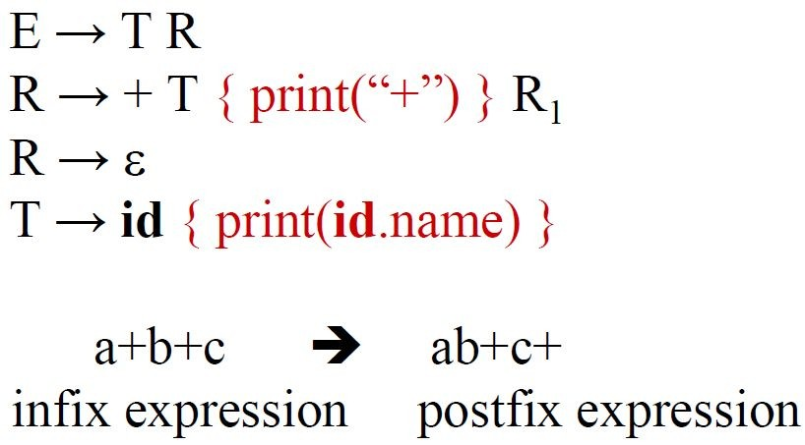
Example: A simple translation scheme that converts inﬁx expression to the corresponding postﬁx expression

Slide 46
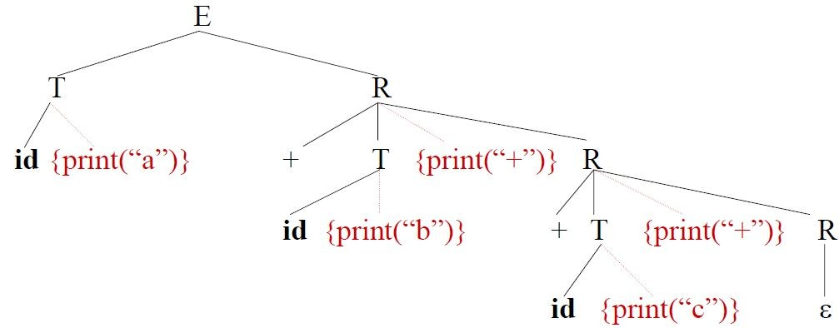
The depth ﬁrst traversal of the parse tree (executing the semantic actions in that order) will produce the postﬁx representation of the inﬁx expression

Slide 47
Translation Scheme Requirements
If a translation scheme has to contain both synthesized and inherited attributes, we have to observe the following rules:
An inherited attribute of a symbol on the right side of a production must be computed in a semantic action before that symbol.
A semantic action must not refer to a synthesized attribute of a symbol to the right of that semantic action.
A synthesized attribute for the non-terminal on the left can only be computed after all attributes it references have been computed (we normally put this semantic action at
the end of the right side of the production).

Slide 48
Translation Scheme Requirements
With an L–attributed syntax-directed deﬁnition, it is always possible to construct a corresponding translation scheme which satisﬁes these three conditions
This may not be possible for a general syntax-directed translation

Slide 49
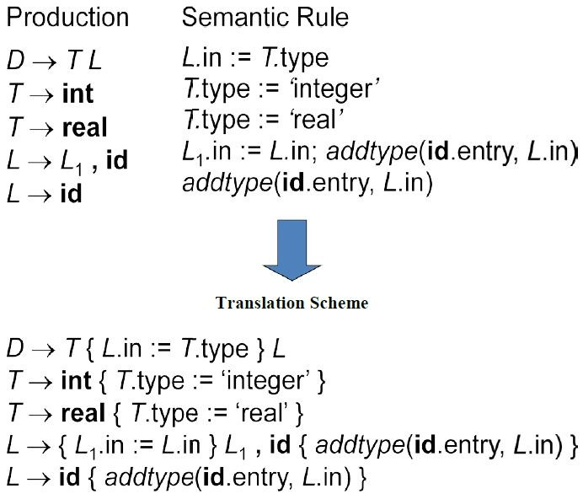

Slide 50
Top-Down Translation
L–attributed deﬁnitions can be evaluated in a top-down fashion (predictive parsing) with translation schemes
Since no grammar with left recursion can be parsed deterministically top-down, we used left-recursion elimination algorithm
The algorithm for elimination of left recursion is extended to evaluate action and attribute

Slide 51
Eliminating Left Recursion from a Translation Scheme
We can implement translation of L–attributed deﬁnition for top down parser by using the method that is similar to the removal of left recursion from the grammar with the following rule:

Slide 52
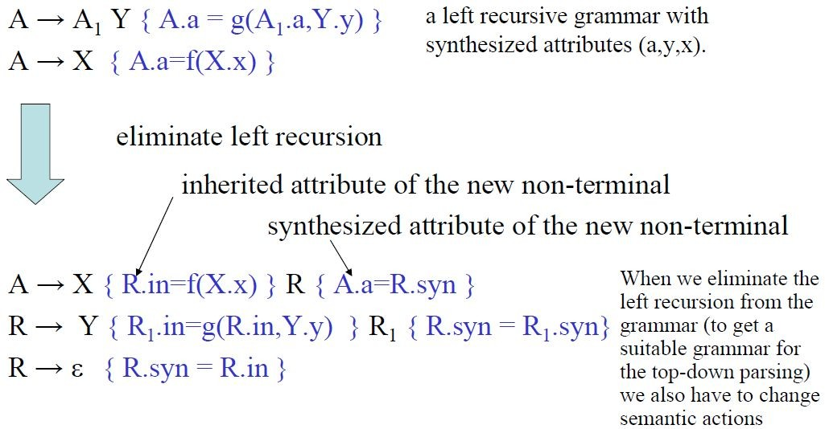

Slide 53
Eliminating Left Recursion from a Translation Scheme
The inherited attribute R.i is evaluated immediately before a use of R in the body, while the synthesized attributes A.a and R.s are evaluated at the ends of the productions
Thus, whatever values are needed to compute these attributes will be available from what has been computed to the left

Slide 54
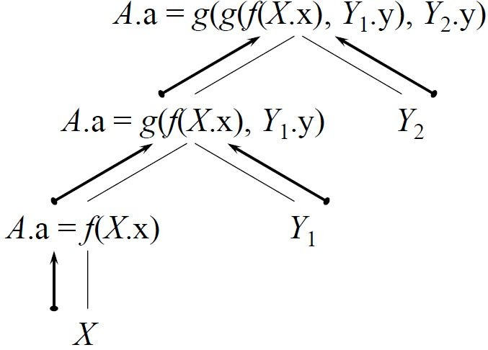
Evaluation Example
Evaluation of string XYY

Slide 55
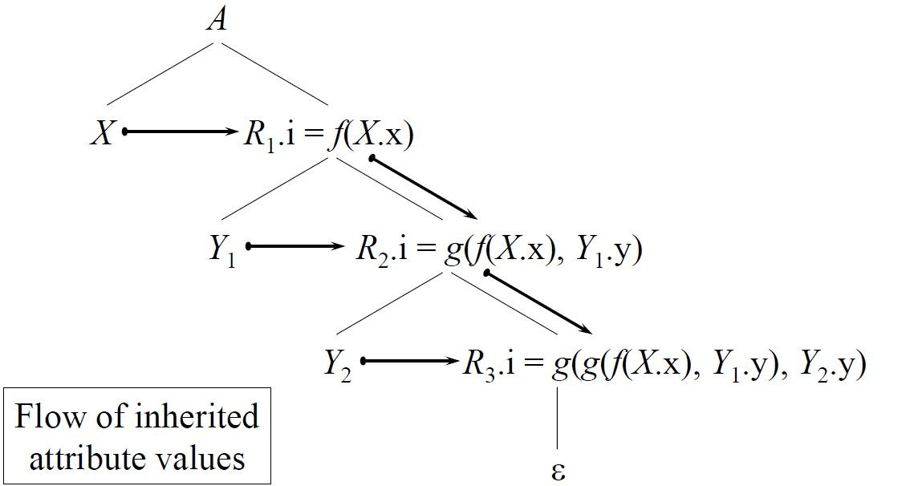

Slide 56
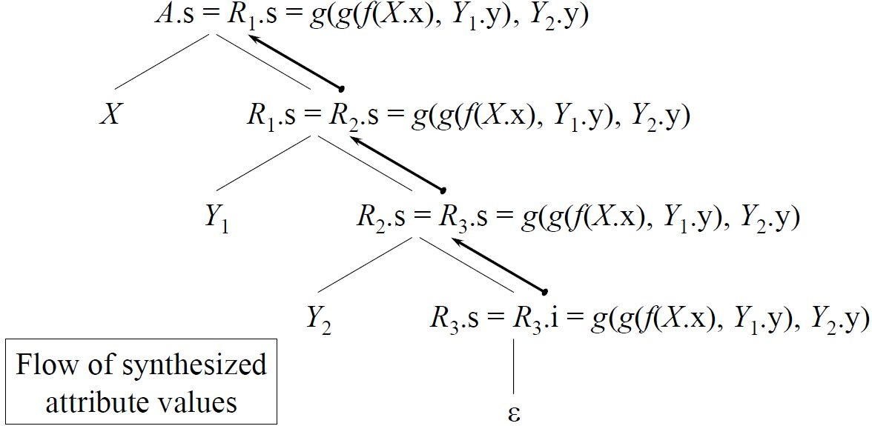

Slide 57
Bottom-Up Evaluation of Inherited Attributes
L–attributed deﬁnitions are a simple subclass of inherited attributes that can be effectively implemented in most bottom-up parsers
If we are able to identify the position of inherited attribute in the stack, then simple assignment of the value stored in the stack may be used to implement the L-attributed deﬁnition in bottom-up manner

Slide 58
Bottom-Up Evaluation of Inherited Attributes
The method used in bottom-up evaluation of
S-Attributed Deﬁnitions is extended with conditions:
All embedding semantic actions in translation scheme should be in the end of the production rules
All inherited attributes should be copied into the synthesized attributes (most of the time synthesized attributes of new non-terminals)
Evaluate all semantic actions during reductions

Slide 59
Removing Embedding Semantic Actions
Insert marker non-terminals to remove embedded actions from translation schemes; that is, A → X{ actions }Y is rewritten with marker non-terminal N as
A → X N Y
N → ε { actions }
Problem: inserting a marker nonterminal may introduce a conﬂict in the parse table

Slide 60
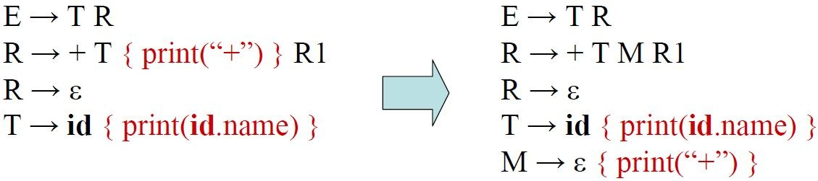
Removing Embedding Semantic Actions

Slide 61
Example of Bottom-Up Evaluation
Consider the following grammar:
E → T {L.type = T.val} L i.e. {print val[top] = val[top – 1]}
L → L, id {settype(id.entry, L.type)} i.e. {settype (val[top] = val[top – 3])}
L → id {settype(id.entry, L.type)} i.e. {settype (val[top] = val[top – 1])}
T → int{T.val = int} i.e. {val[top] = int}
T → ﬂoat{T.val = ﬂoat} i.e. {val[top] = ﬂoat}

Slide 62
Example of Bottom-Up Evaluation
Consider type declaration of variables in C: ﬂoat a,b;
Given a string of the form ﬂoat id,id a bottom-up evaluation can be traced as follows:

Slide 63
Input | State | Value (Stack) | Action
ﬂoat id,id$ | $
id,id$ | $ﬂoat | ﬂoat | shift
id,id$ | $T | ﬂoat | T→ﬂoat (reduce)
,id$ | $T id | ﬂoat _ | shift
,id$ | $T L | ﬂoat ﬂoat | L→id
id$ | $T L, | ﬂoat ﬂoat _ | shift
$ | $T L, id | ﬂoat ﬂoat _ _ | shift
$ | $T L | ﬂoat ﬂoat | L→L, id
$ | $E | ﬂoat | E→T L

Slide 64
Applications of Syntax-Directed Translation
Syntax-directed translations are used for the construction of syntax trees
The syntax-directed translation techniques are also applied for type checking and intermediate code generation
SDT is used for executing arithmetic expressions
SDT is used in the conversion from inﬁx expression to postﬁx/preﬁx expression
SDT is used in counting number of reductions
It is also used for storing information into symbol table

